Slide 1
Big Mountain resort price prediction
Phuc Ton Nguyen

Slide 2
Problem identification
Big Mountain Resort recently just installed a new ski lift that increases their seasonal expenditures by 1.5 million dollars and they are trying to implement different business strategies. They are trying to either cut costs to accommodate or they are to charge a premium on the regular price of the tickets.
The data science team is responsible to model the new price of ticket sales in respect to the seasonal expenditures in order to measure the efficacy of our business strategies to cut cost without undermining the ticket price

Slide 3
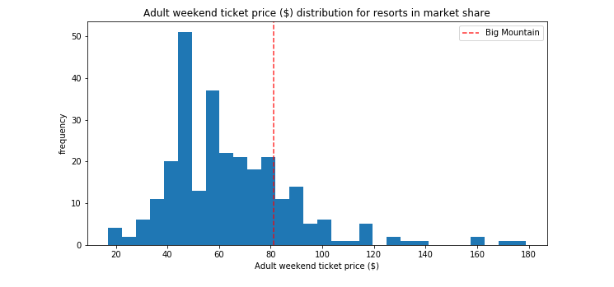
Recommendation and key findings
When comparing the ticket price of Big Mountain Resort with other competitors in the USA as per the overall facilities provided by the resorts, there is a prediction that our ticket prices are worth $94. This is an overall 16% increase over our current ticket price.

Slide 4
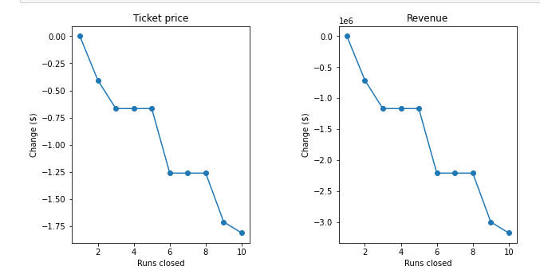
Recommendation and key findings
Big Mountain is adding a run, increasing the vertical drop by 150 feet, and installing an additional chair lift. This scenario increases support for ticket price by $1.99, increase revenue to $3474638
Repeating the previous one but adding 2 acres of snow making. This increases support for ticket price by $1.99 and increase revenue by $3474638
Close up to 10 of the least used runs.

Slide 5
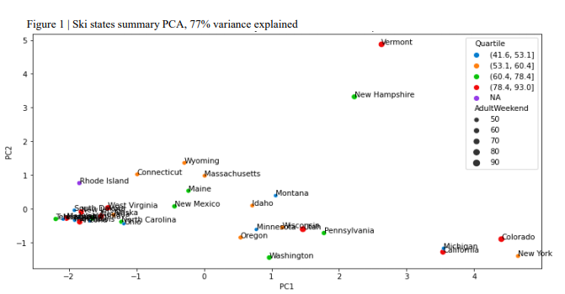
Modeling results and analysis
Aftering perform a PCA there wasn't a clear way to segment the states which gives us some evidence on why we should treat all the states equally moving forward

Slide 6
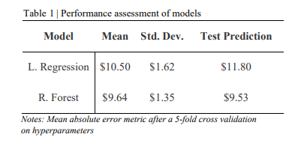
Modeling results and analysis
Linear Regression: after optimizing the model and running a cross-validation the average of all the mean absolute errors was $10.50 with a standard deviation of $1.62. The performance of this model is significantly better than the Dummy Regressor. When used to predict the price on the test set this model outputted a ticket price of $11.80.
Random Forest: completed the same steps as in the linear regression model with an average mean absolute error of $9.64 and a standard deviation of $1.35. With a smaller average mean absolute error and a tighter standard deviation the random forest model performed the best and was chosen as our model going forward. When used to predict the price on the test set this model outputted a ticket price of $9.53.

Slide 7
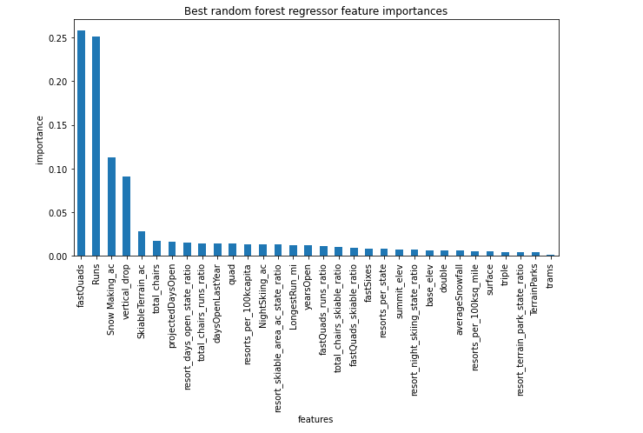
Modeling results and analysis
Important features:

Slide 8
Summary and conclusion
The model predicts the Big Mountain Resort should have the price $95.87 compared to the current price of $81
Adding a run, increasing the vertical drop by 150 feet, and installing an additional chair lift will increase support for ticket price by $1.99, increase revenue to $3474638

